Slide 1
Greedy Algorithms

Slide 2
The Knapsack Problem
More formally, the 0-1 knapsack problem:
The thief must choose among n items, where the ith item worth v_{i} dollars and weighs w_{i} kgs
Carrying at most W kgs, maximize value
Note: assume v_{i}, w_{i}, and W are all integers
“0-1” because each item must be taken or left in entirety
A variation, the fractional knapsack problem:
Thief can take fractions of items
Think of items in 0-1 problem as gold ingots, in fractional problem as buckets of gold dust.

Slide 3
Optimal Substructure Property
Both problems exhibit the optimal substructure property.
To show this for both the problems, consider the most valuable load weighing at most W kgs
Q: If we remove item j from the load, what do we know about the remaining load?
A: The remaining load must be the most valuable load weighing at most W - w_{j} that the thief could take from the n-1 original items excluding item j.

Slide 4
Fractional Knapsack Problem
Knapsack capacity: W
There are n items: the i-th item has value v_{i} and weight w_{i}
Goal:
find x_{i} such that for all 0 ≤ x_{i} ≤ 1, i = 1, 2, .., n
∑ w_{i}x_{i} ≤ W and
∑ x_{i}v_{i} is maximum

Slide 5
Fractional Knapsack - Example
50
20
---
30
50
E.g.:
$80
+
Item 3
Item 2
30
20
$100
+
Item 1
20
10
10
$60
$60
$100
$120
$240
$6/kg
$5/kg
$4/kg

Slide 6
Fractional Knapsack Problem
Greedy strategy 1:
Pick the item with the maximum value
E.g.:
W = 1
w₁ = 100, v₁ = 2
w₂ = 1, v₂ = 1
Taking from the item with the maximum value:
Total value taken = v₁/w₁ = 2/100
Smaller than what the thief can take if choosing the other item
Total value (choose item 2) = v₂/w₂ = 1

Slide 7
Fractional Knapsack Problem
Greedy strategy 2:
Pick the item with the maximum value per kg v_{i}/w_{i}
If the supply of that element is exhausted and the thief can carry more: take as much as possible from the item with the next greatest value per kg
It is good to order items based on their value per kg

Slide 8
Fractional Knapsack Problem
Alg.: Fractional-Knapsack (W, v[n], w[n])
While w > 0 and as long as there are items remaining
pick item with maximum v_{i}/w_{i}
x_{i} ← min (1, w/w_{i})
remove item i from list
w ← w – x_{i}w_{i}
w – the amount of space remaining in the knapsack (w = W)
Running time: Θ(n) if items already ordered; else Θ(nlgn)

Slide 9
0-1 Knapsack problem
Thief has a knapsack with maximum capacity W, and a set S consisting of n items
Each item i has some weight w_{i} and benefit value v_{i} (all w_{i} , v_{i} and W are integer values)
Problem: How to pack the knapsack to achieve maximum total value of packed items?
Goal:
find x_{i} such that for all x_{i} ∈ {0, 1}, i = 1, 2, .., n
∑ w_{i}x_{i} ≤ W and
∑ x_{i}v_{i} is maximum

Slide 10
0-1 Knapsack - Greedy Strategy Fails
50
50
50
30
Item 3
$120
+
Item 2
30
20
$100
+
Item 1
20
20
$100
10
10
$60
$60
$100
$120
W
$160
$220
$6/kg
$5/kg
$4/kg

Slide 11
Activity-Selection Problem
Input:
A set of n activities, each with start and end times: A[i].s and A[i].f. The activity last during the period [A[i].s, A[i].f)
Output:
The largest subset of mutually compatible activities
Activities are compatible if their intervals do not intersect
8
2
5
9
1
3
6
4
7
Time
0 1 2 3 4 5 6 7 8 9 10 12 14 16 18 20 22

Slide 12
Greedy choice
What if we could choose “the best” activity (as of now) and be sure that it belongs to an optimal solution
We wouldn’t have to check out all these sub-problems and consider all currently possible choices!
Idea: Choose the activity that finishes first!
Then, solve the problem for the remaining compatible activities

Slide 13
0 1 2 3 4 5 6 7 8 9 10 11 12 13 14 15

Slide 14
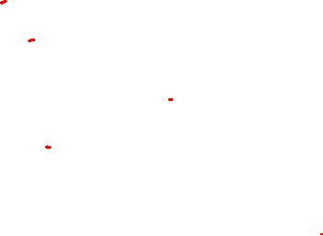
0 1 2 3 4 5 6 7 8 9 10 11 12 13 14 15

Slide 15
0 1 2 3 4 5 6 7 8 9 10 11 12 13 14 15

Slide 16
0 1 2 3 4 5 6 7 8 9 10 11 12 13 14 15

Slide 17
0 1 2 3 4 5 6 7 8 9 10 11 12 13 14 15

Slide 18
0 1 2 3 4 5 6 7 8 9 10 11 12 13 14 15

Slide 19
0 1 2 3 4 5 6 7 8 9 10 11 12 13 14 15

Slide 20
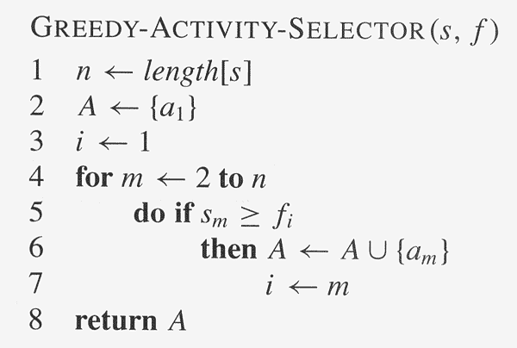
Assuming activities are sorted by finish time

